Slide 1
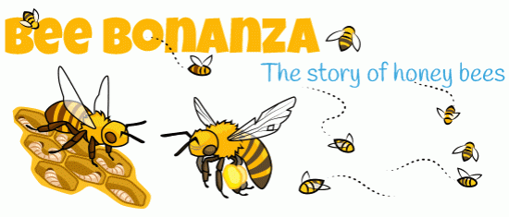
Communication in Bees
Dr. Arnab Ganguli
Assistant Professor and Head
PG Department of Zoology
B B College, Asansol

Slide 2
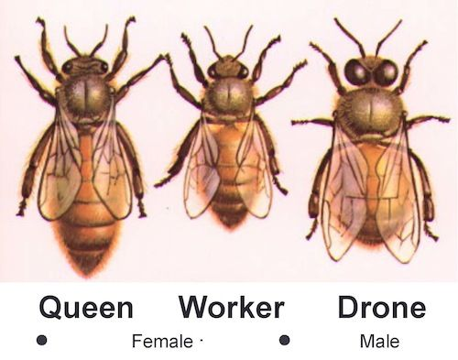
The Bee Colony

Slide 3
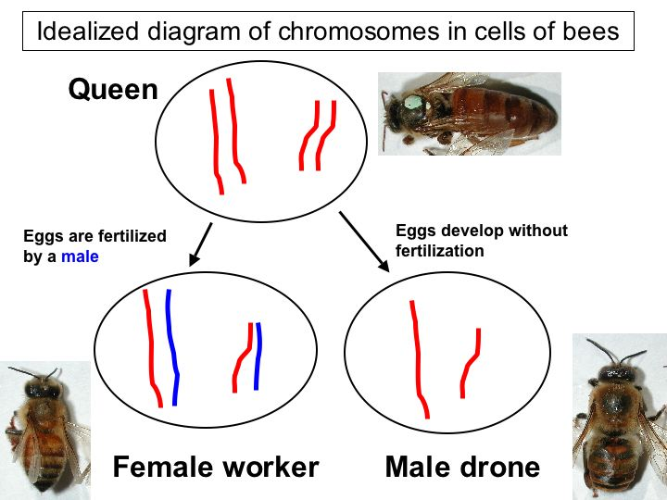
Haplodiploidy

Slide 4
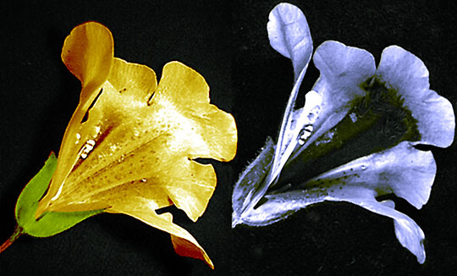
The World of a Bee
Honey bees use all of their senses to find the best flowers including: smell, color, shape, location, petal textures, and time of day
Bees see flowers differently than humans. They can see visible light and also ultraviolet (UV) light.

Slide 5
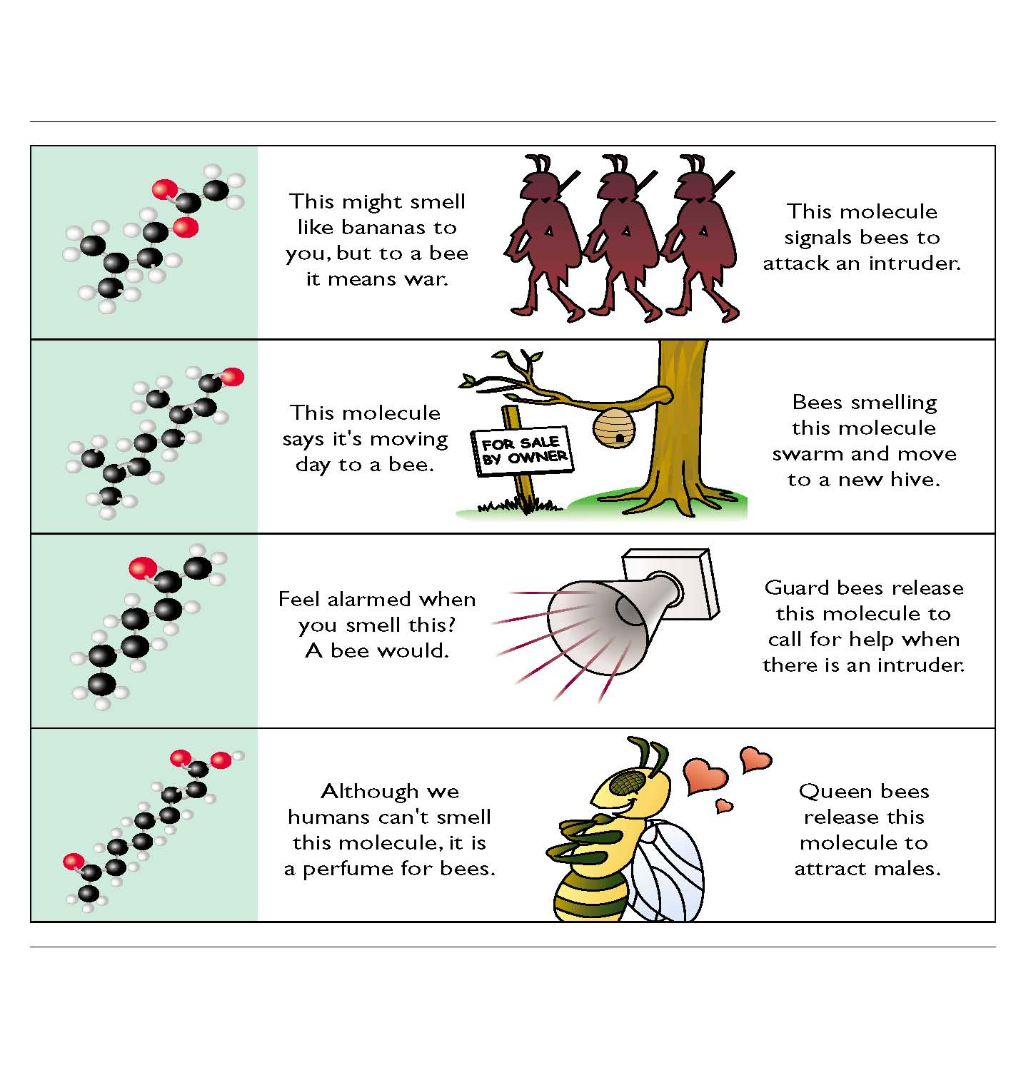
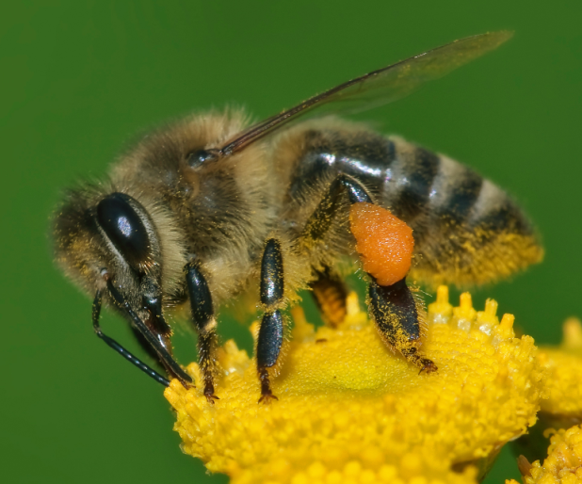
Pheromones
are the first
line of
communication

Slide 6
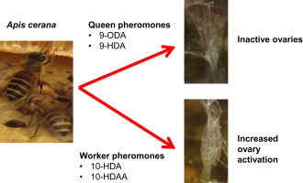
The Queen releases pheromones
which make the workers sterile

Slide 7
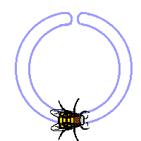
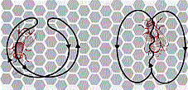
The Round Dance
When food is less than 100 meters away
5–25% of the workers in the hive are scouts. Their job is to search for new sources of food for the other workers, the foragers, to harvest.
When food is within 50–75 meters of the hive, the scouts dance the "round dance" on the surface of the comb

Slide 8
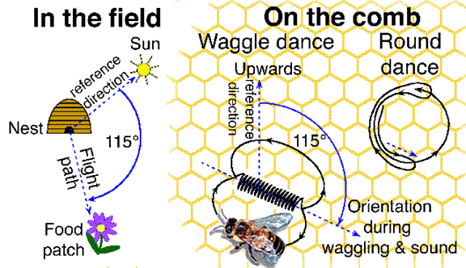
The Waggle Dance
When food is more than 100 meters away
But when the food is farther than 100 meters from the hive, the scouts dance the "waggle dance"

Slide 9
Thank you
Enjoy your/with your
honey
Karl von Frisch won the Nobel in 1973 for his work in Bee Communication

